Slide 1
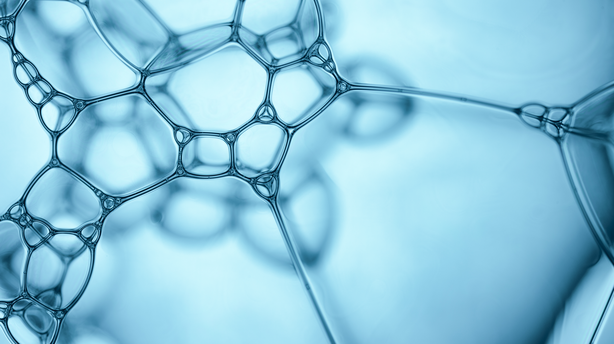
Part II labs

Slide 2
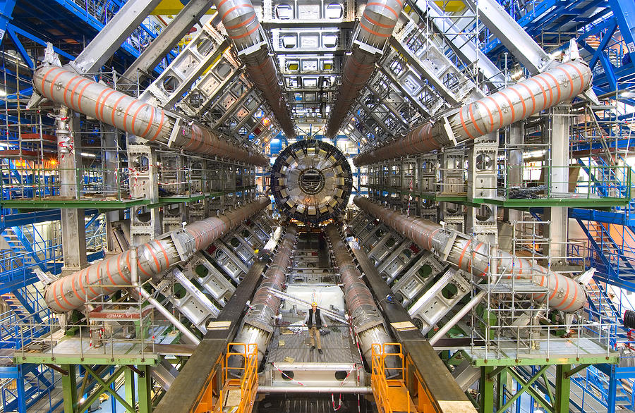
Where am I?

Slide 3
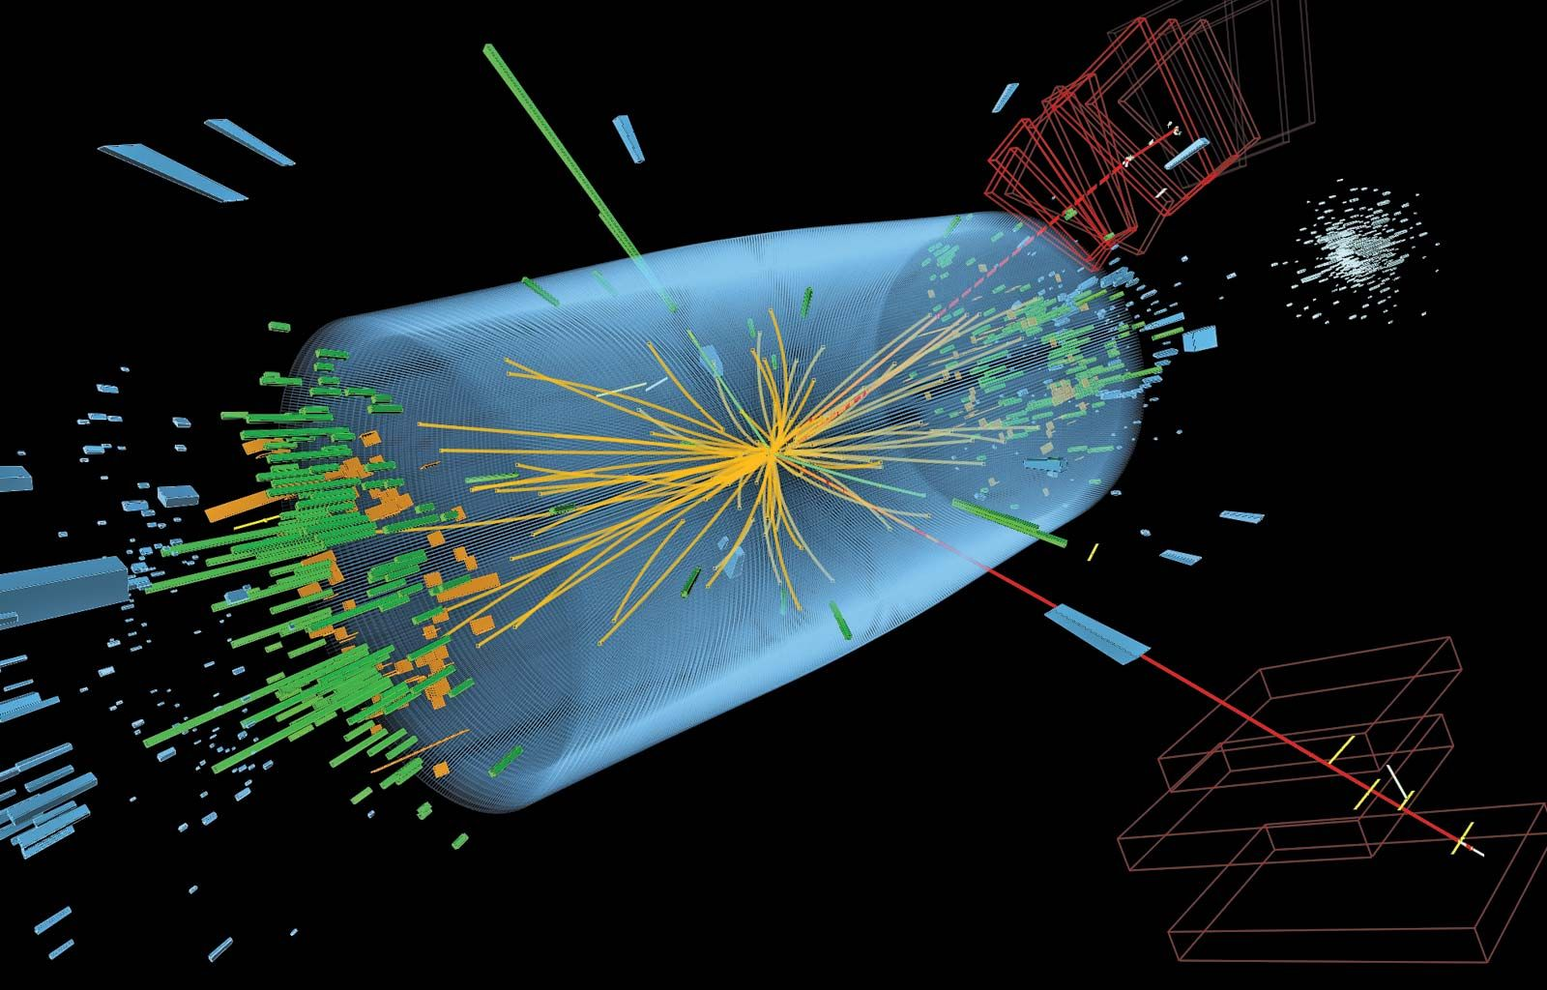
France/ Switzerland: ATLAS detector

Slide 4
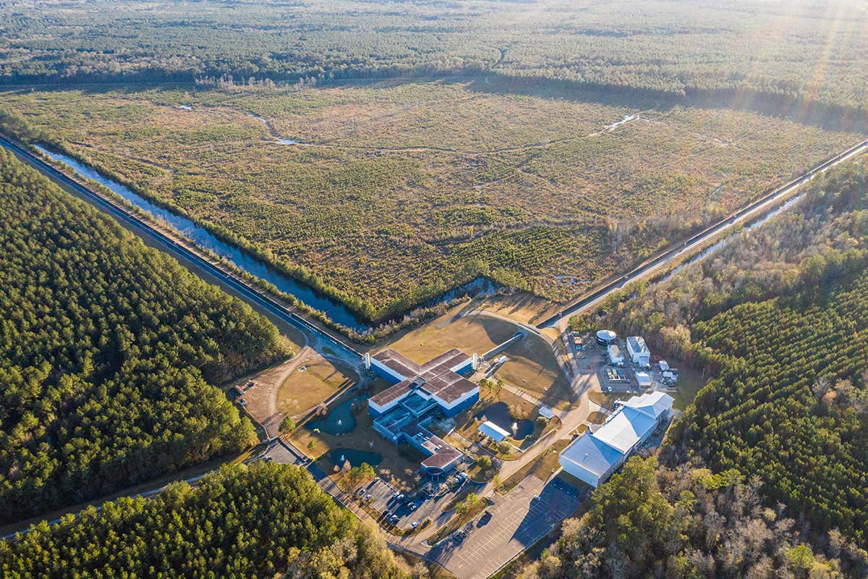
Where am I?

Slide 5
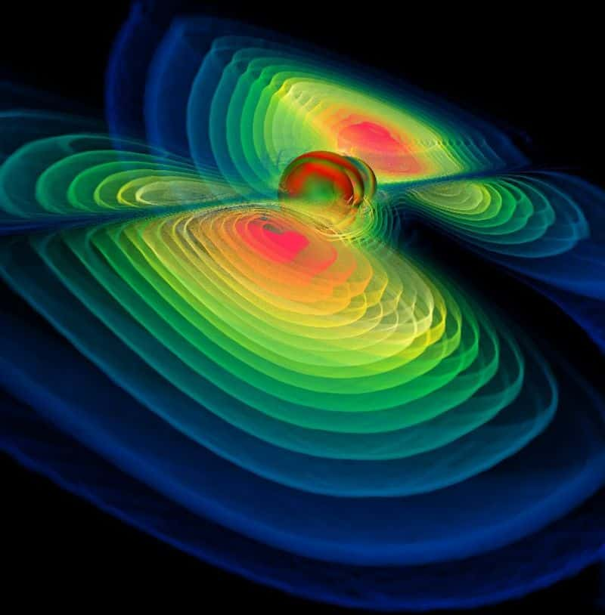
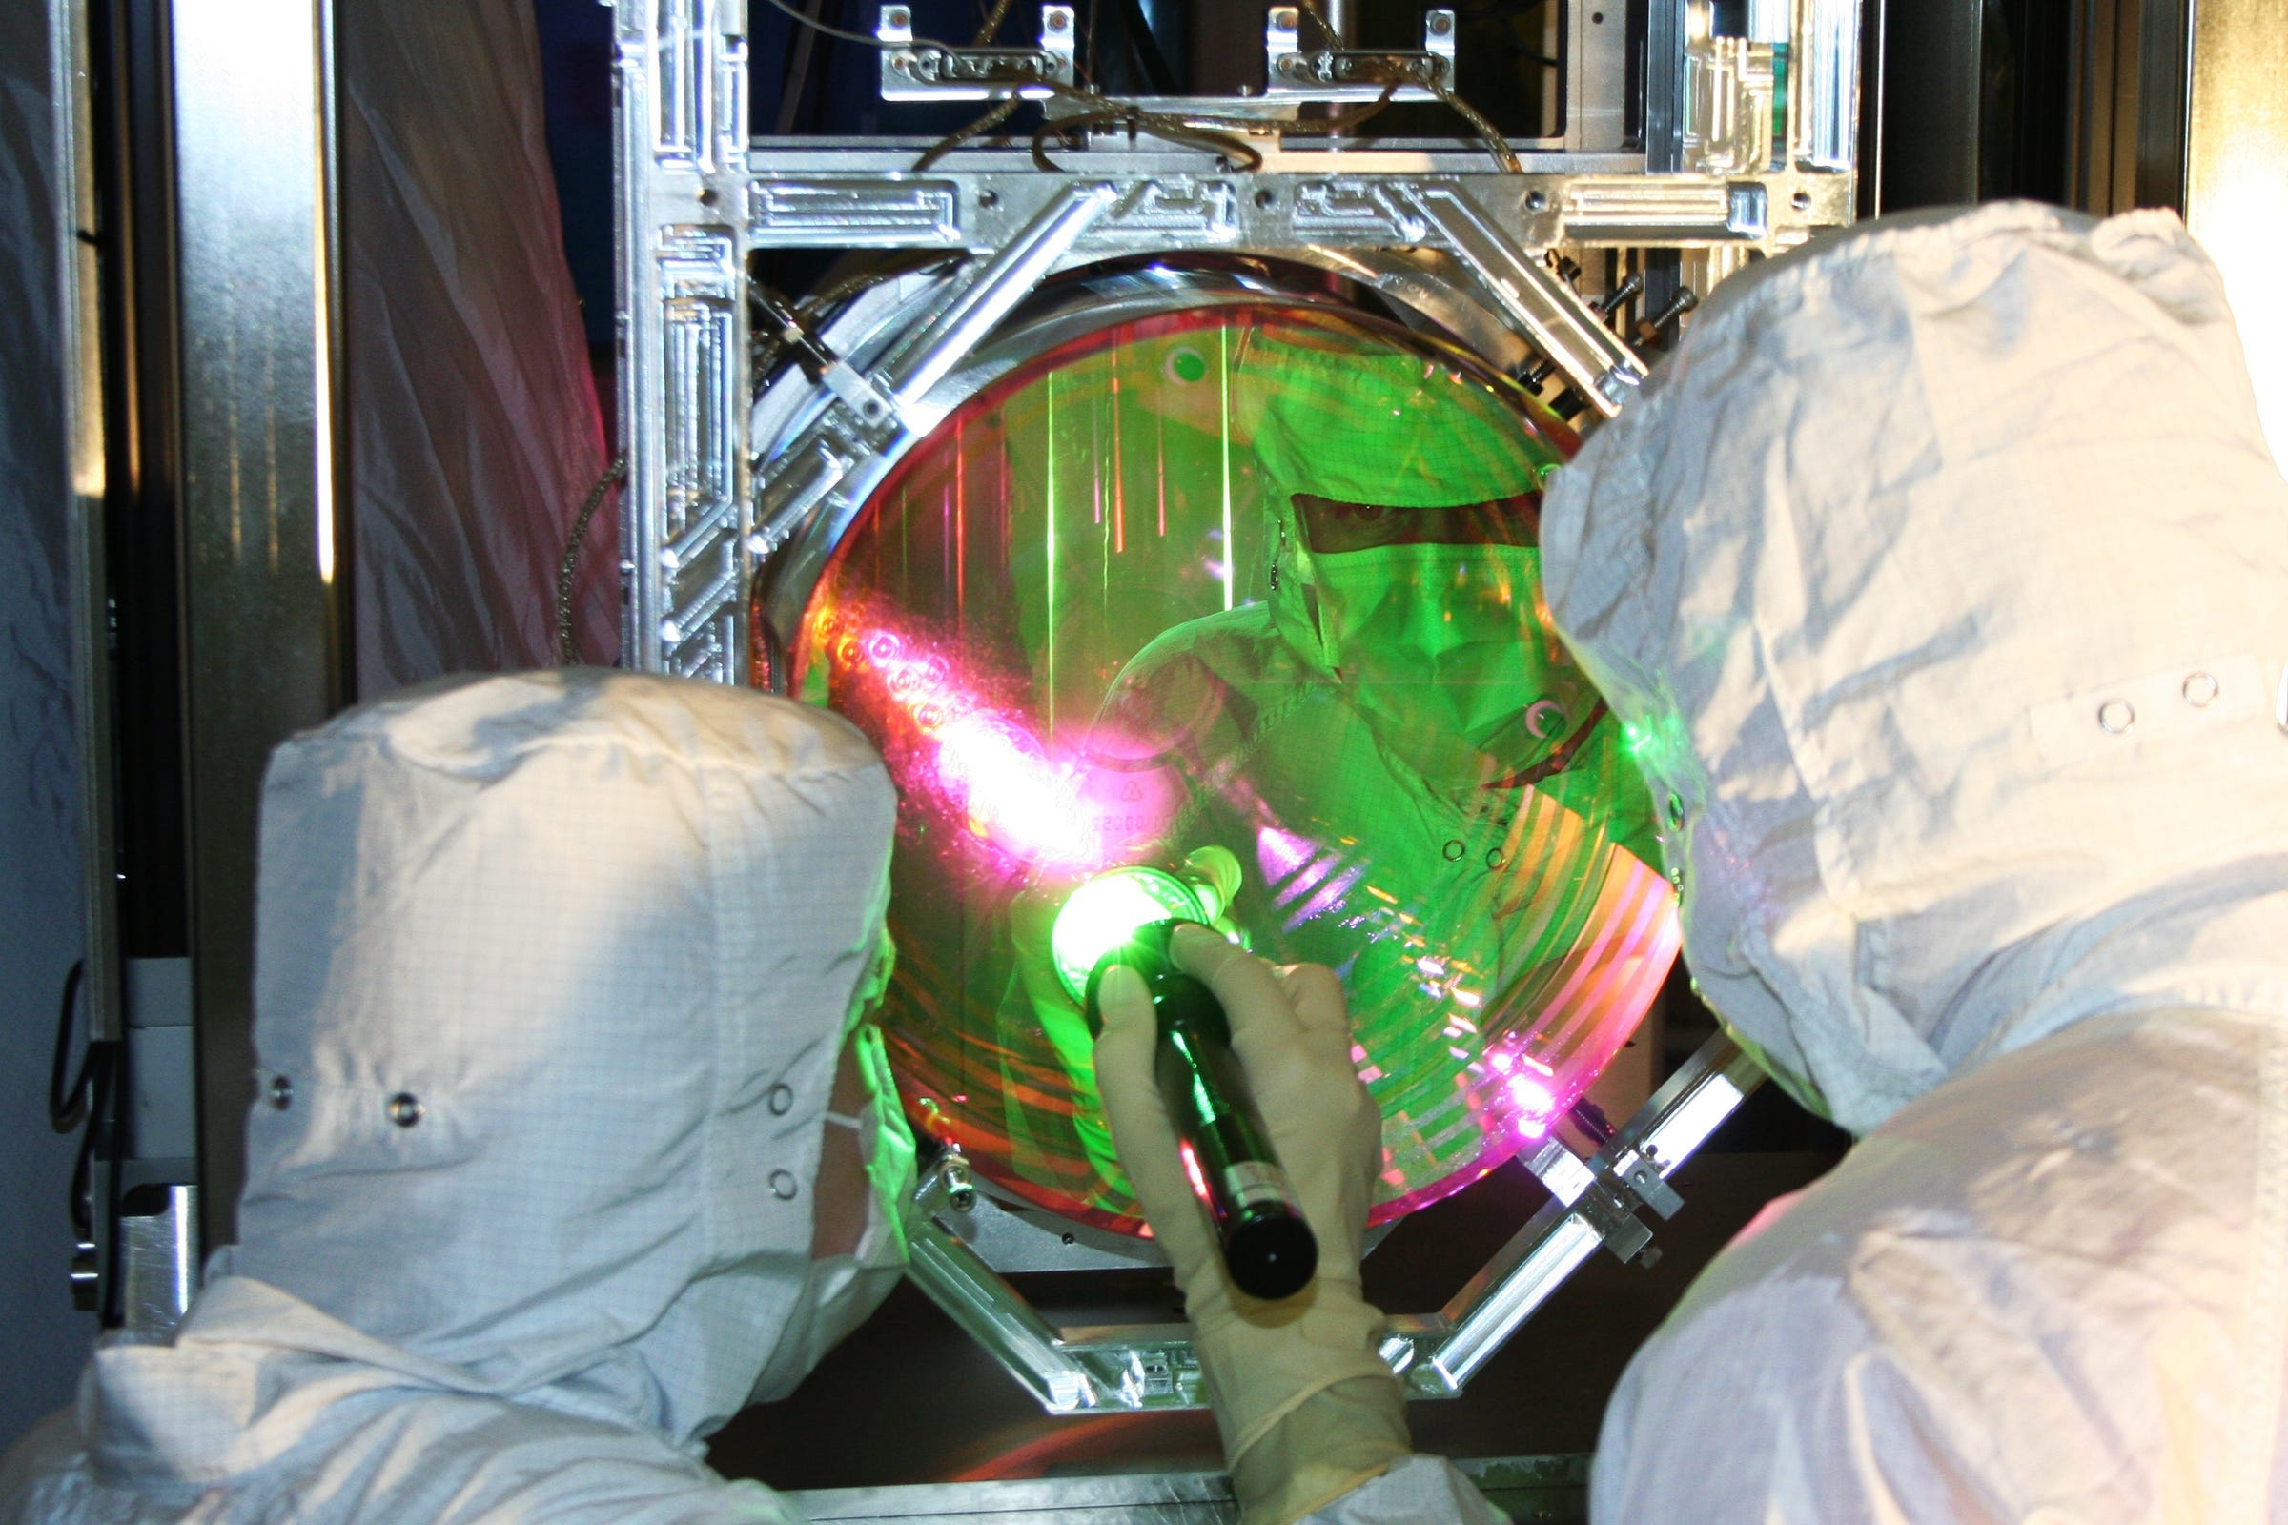
USA: LIGO

Slide 6
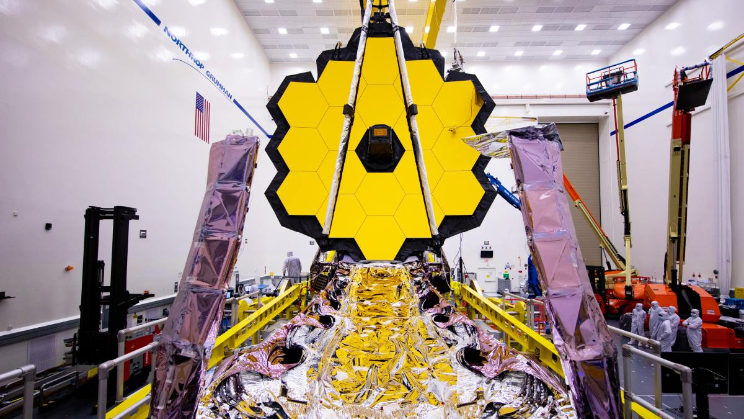
Where am I?

Slide 7
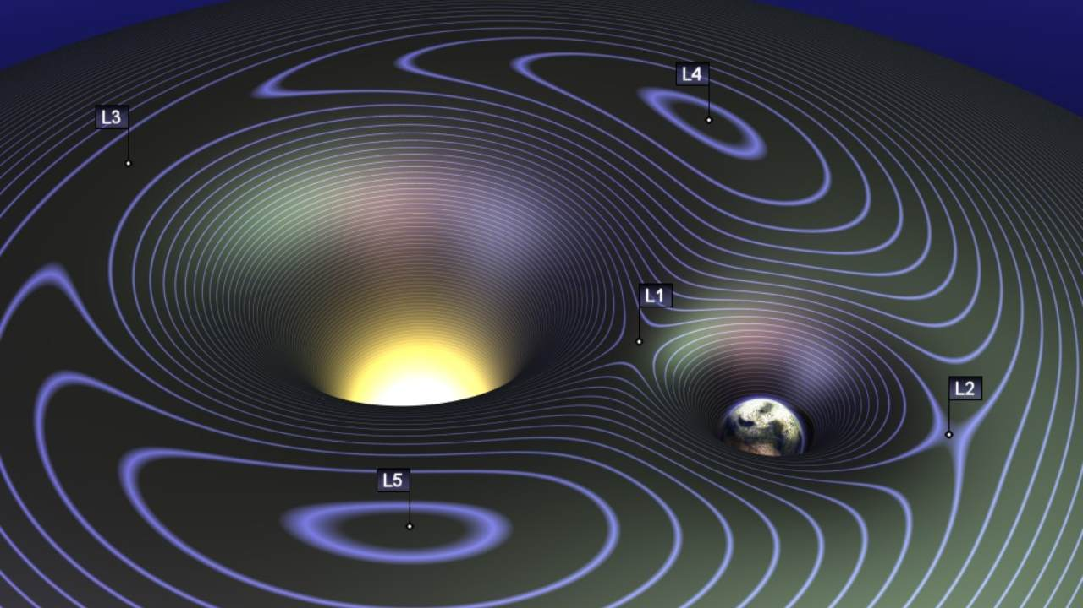

Lagrange point 2: James Webb telescope

Slide 8
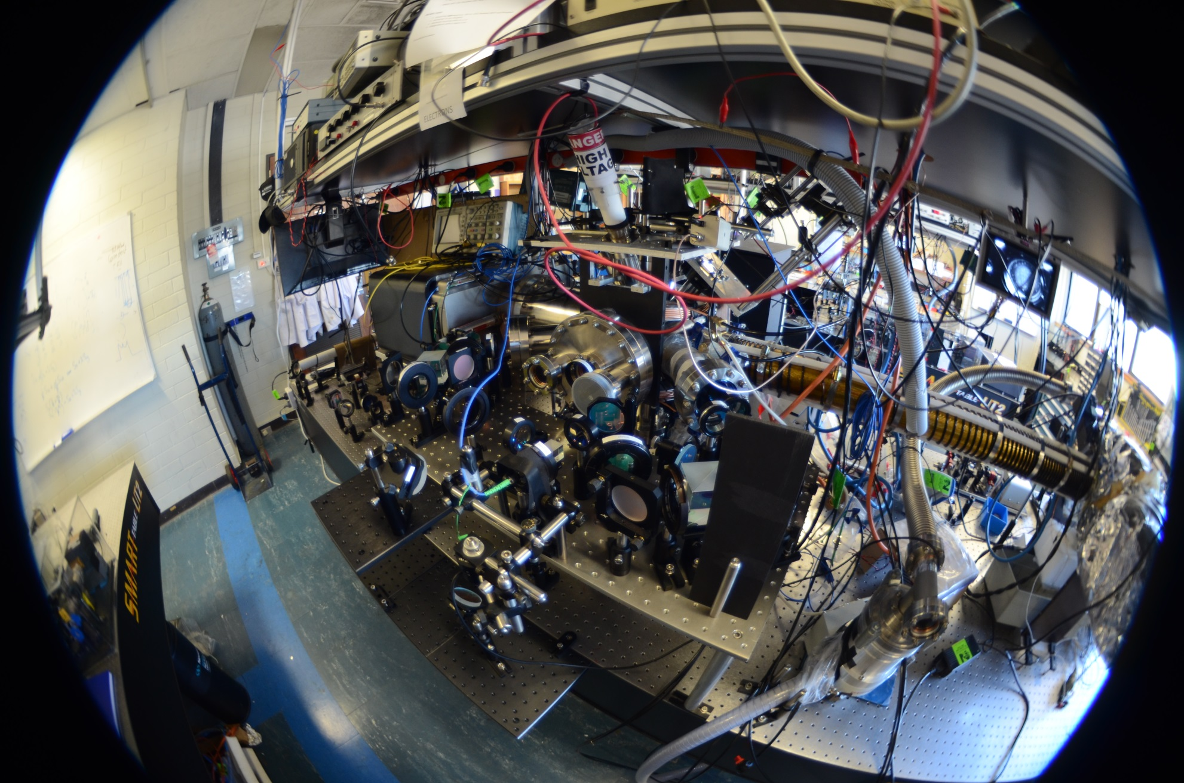
Where am I?

Slide 9
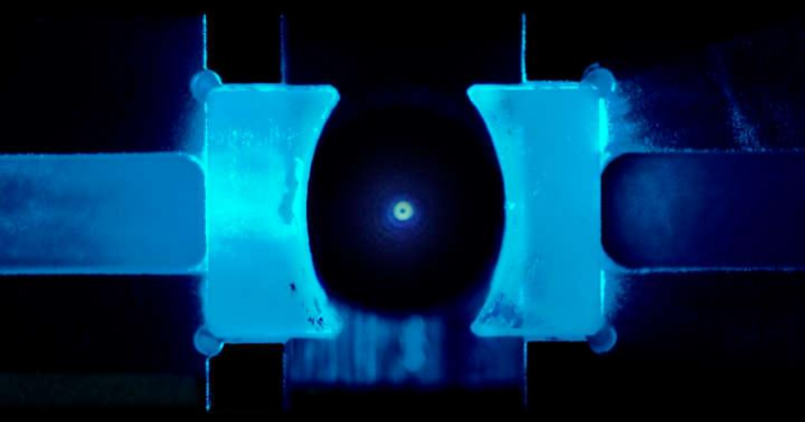
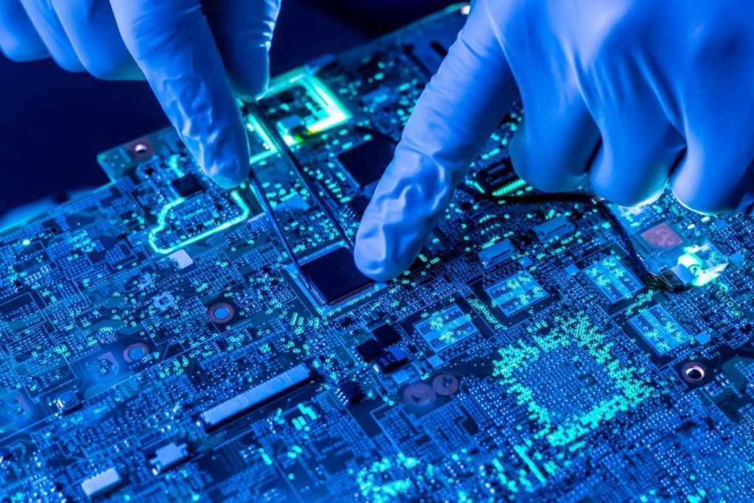
Melbourne

Slide 10
Why experiment?

Slide 11
What is the point of (science) labs?

Slide 12
How does your experience of labs compare?

Slide 13
Do you expect an experiment to aid you understanding of physics? Do you need to understand how the measurement tools and sensors work in order to carry out an experiments? Communicating scientific results is a valuable part of doing physics experiments

Slide 14
Lab methodology
POLUS: https://utasphys.cloud.edu.au/POLUS/

Slide 15
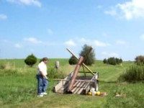
What is safety? What is dangerous?

